Slide 1

Covid Data Analysis
Yongqi Liang
Notes:
Hello and welcome, my name is Yongqi and today I will be presenting to you the results of the Data Analytics task.

Slide 2
Contents
Data preprocessing
Findings
Data modelling
Forecasting
Notes:
These are the contents, I will firstly go through the data pre-processing steps,
After that I will show you some findings of the data set
Then I will do data modelling
And finally is the forecasting of daily new cases in different countries

Slide 3

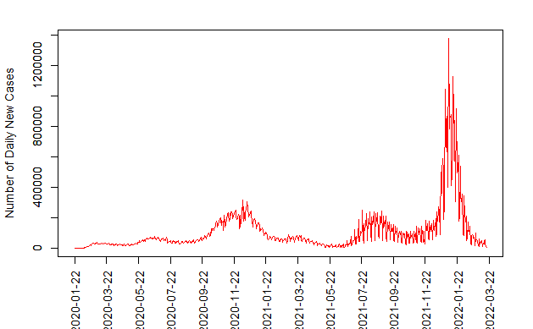

Data preprocessing
- Data understanding
- Data cleaning & Data extraction
Step1: Drop the unnecessary columns: Province/State, Lat, Long, UID, Iso2, Iso3, Code3, FIPS, Admin2, Province_State, , Lat, Long_, Combined_Key
Step2: Extract new data sets:
Cumulative daily case -> daily new case
Daily new case -> daily new case in the US,…
Step3: Data visualization & data cleaning:
Example:
Data sets:
1.Cumulative confirmed cases daily
- Province/State, Country/Region, Lat, Long, 1/22/20, 1/23/20,…,3/20/2022
2. Population lookup table
- UID, Iso2, Iso3, Code3, FIPS, Admin2, Province_State, Country_Region, Lat, Long_, Combined_Key, Population
Solution: replace it by mean(previous day, the next day)
Daily new cases in the US from 2020/1/22 to 2022/3/20
Notes:
Let get started with data pre-processing
-the key to success on any data project is to understand the data in detail. For this task, I only use these 2 data sets. The first one is about the amount the cumulative confirmed cases daily, with attribute province/State, Country/region, lat, long , date,…
The next one is the population look up table.which contain information about the population in different country and region.
After looking through the data sets, I need to do some cleaning and extract some useful data.
For cleaning the data, I drop the unnecessary columns, such as lat, long, lso2, … as I don’t need these information for my analysis.
Then I need to extract some useful data, for example, I can get the daily new case data set from the cumulative daily case data set by using the differ() function. Then by using the filter function in the tidyverse package in R, I can get the daily new case in different countries
After that, I want to do further cleaning, so I plot the data set that I want, to see if there exist any outlier. For example, I visualized the daily new cases in the US. And the plot show that there is an observation have an extremely large value, it might be an outlier. So I search online to see if this data is correct. The information online shows that the US never had a day have over 1, million new cases, which indicate it is an error. So I replaced this value by the mean of its previous value and its next value.

Slide 4
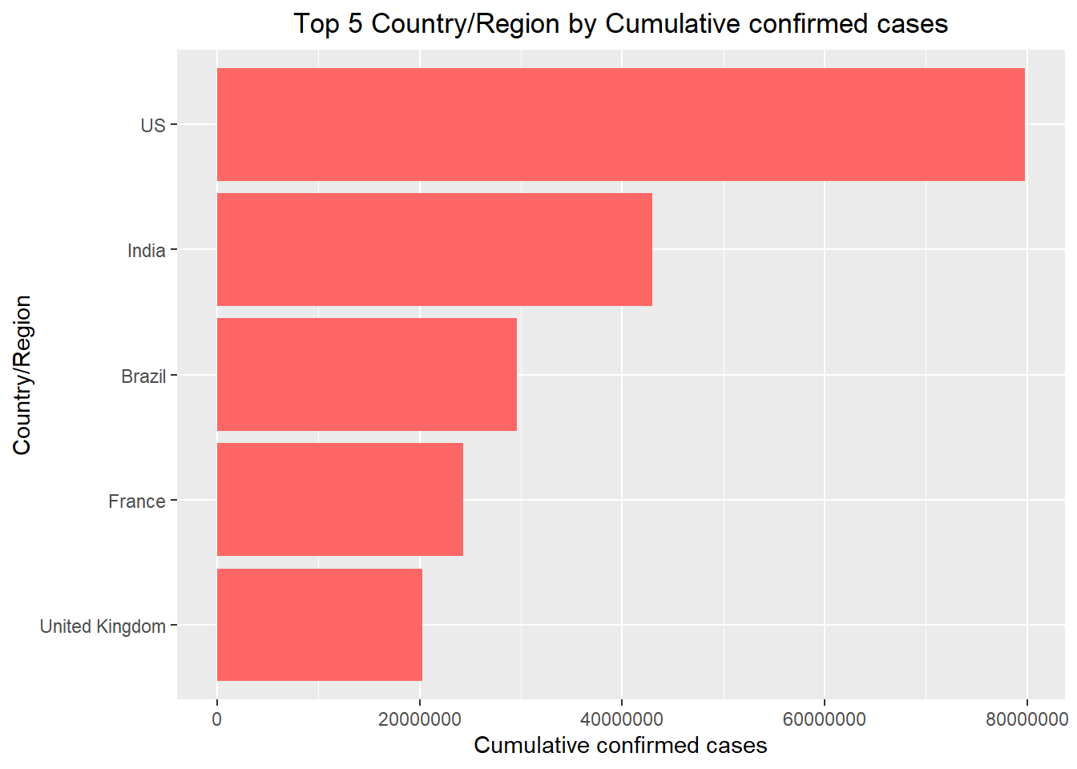
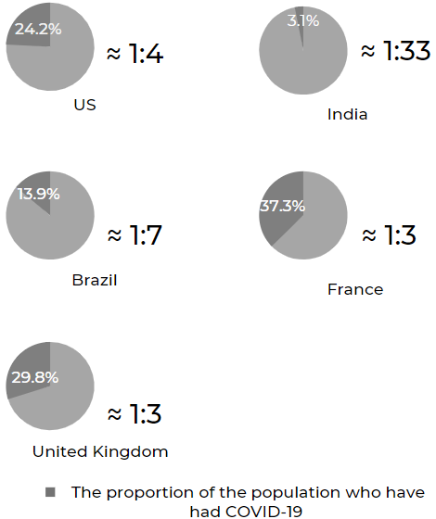
Findings
2020/1/22 to 2022/3/20
Notes:
The bar chart on the left hand side shows the top 5 countries by their cumulative cases. US has the highest cases for this period of time, around 80 million
, followed by India…., and the right side we have pie charts representing the covid cases per the country population
Although India have the second highest cumulative cases, but there is only 1 in 33 people have had covid. While in France, 1 in 3 people have had covid
I will be using some of these countries along with new Zealand to do forecasting.

Slide 5
Forecasting model- Time Series Analysis (ARIMA MODEL) Predicting number of new daily Covid19
Why Time Series Analysis?
The x axis is made up of equally spaced points in time.
The y axis contains the outcome values that are going to be projected from our model based on previous observed values.
The outcome variable in our model is dependent on one single explanatory variable only: time.
Notes:
Now we want to Predicting number of new daily Covid19 cases using Time Series Analysis
The time series model that i was selected to make the prediction is called Auto Regressive Integrated Moving Average (ARIMA) model.
Time series analysis (TSA) is a statistical technique that consists of data points listed in time order.
Why I select time series analysis here?
This is because our x axis is made up of equally spaced points in time
and the y axis contains the outcome values that are going to be projected from our model based on previous observed values
. Also, the outcome variable in our model is dependent on one single explanatory variable only: time.
These all factor indicates that I can use arima model here.

Slide 6
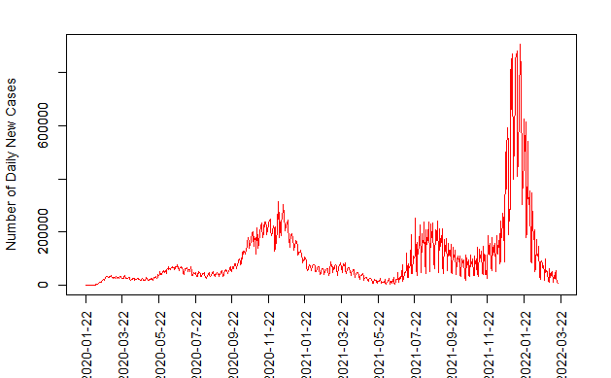
Process of building a Arima Model – assumptions check
Assumptions:
Data has to be stationary.
Data should be univariate.
Data should be in time series data format.
Stationary data:
Mean has to be constant according to the time.
Variance has to be equal in different time intervals from the mean.
Covariance has also to be equal.
Daily new cases in the US from 2020/1/22 to 2022/3/20
Notes:
In Time Series Analysis ARIMA the following assumptions have to be met:
Data has to be stationary.
Data should be univariate. As mentioned above TSA works on a single variable only.
Data should be in time series data format
In order to have stationary data, the following conditions have to be met:
Mean has to be constant according to the time.
Variance has to be equal in different time intervals from the mean. In other words, the distance of the points should be the same from the mean.
Covariance has also to be equal.
Lets take US as an example,
The graph above shows the number of Daily new cases in the US from 2020 to 2022.
The blue line displays the mean and as we can see,the mean is constantly increasing.
First, we can see that the means aren’t constant, therefore the data is violating the assumption for constant mean throughout the time.
Secondly, we also see that the variances aren’t equal. As we can see the distance between the points and the mean line varies a lot. Consider the points spiking in November 2020 and January 2022. We can clearly see that the distances from the data point to the mean are not the same.
Hence the data violates not only the equal mean assumptions, but also the equal variance assumption.
As a result, we have to transform our data to be stationary.

Slide 7
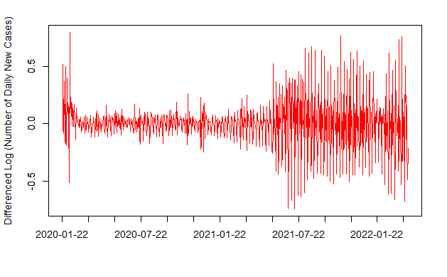


Process of building a Arima Model – Data transformations
Logarithm
- stabilize the variance
Differencing
- stabilize the mean
Constant mean
Constant variance
Notes:
Data transformations such as logarithms can help stabilize the variance for time series analysis. On the other hand, differencing can help stabilize the mean.
Once we applied logarithms and differencing to our data, the graph of our data changed to the following: we can see here how the mean is constant now.
however, the Variance is not equal in different time intervals from the mean. Which indicate we can not use this data set to do forecasting by Arima model.
To solve this problem, I am going to change my training data set.

Slide 8
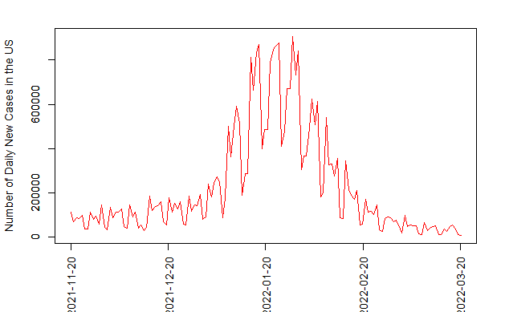
Process of building a Arima Model – Omicron period only
Daily new cases in the US from 2020/1/22 to 2022/3/20
Daily new cases in the US from 2021/11/20 to 2022/3/20
Reasons for changing our data set:
Transmission rate of Omicron is more than 500% faster than all its previous variants.
The variance difference between the Omicron period and before is large, which means the variance is far from constant.
This will affect the model accuracy.
Notes:
Here I change my data set to omicron period only, which mean I only select the data from November 2021 to march 2022.
Reasons for changing our data set:
Transmission rate of Omicron is more than 500% faster than all its previous variants.
The variance difference between the Omicron period and before is large, which means the variance is far from constant.
This will affect the model accuracy.

Slide 9
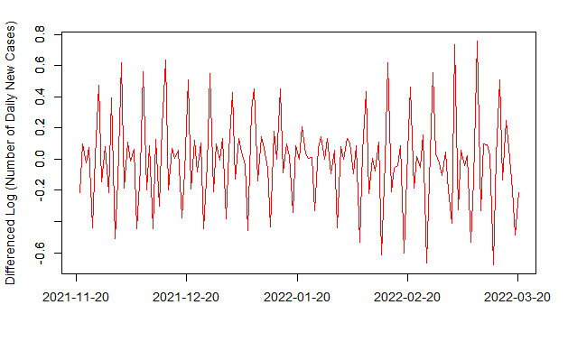
Process of building a Arima Model – Omicron period only
- Data transformations
Daily new cases in the US from 2021/11/20 to 2022/3/20
Differenced Log(Daily new cases in the US from 2021/11/20 to 2022/3/20)
Data transformation
Constant mean
Constant variance
Notes:
. the graph on the left hand side shows that we don’t have stationary data as both The mean and variance are not constant. So we need to applied logarithms and differencing to our data.
The result is on the right hand side, it shows constant mean and roughly constant variance.

Slide 10
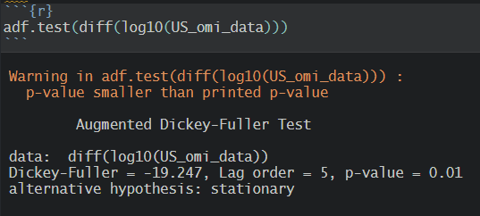
Process of building a Arima Model
- Augmented Dickey-Fuller Test
H0: The null hypothesis is that there is a unit root.
H1: The alternative hypothesis is that the time series is stationary.
The p-value of our test is 0.01 on a significance level of 0.05. Hence, we reject the null hypothesis. In other words, our data is now stationary and we can proceed with the analysis.
Notes:
In order to double check if our data is now stationary, i conducted the Augmented Dickey-Fuller Test, which tells us if our data is stationary or not.
From the test result, we can see that the p value is 0.01 on a significance level of 0.05. Hence, we rejected the null hypothesis. In other words, our data is now stationary and we can proceed with the analysis

Slide 11
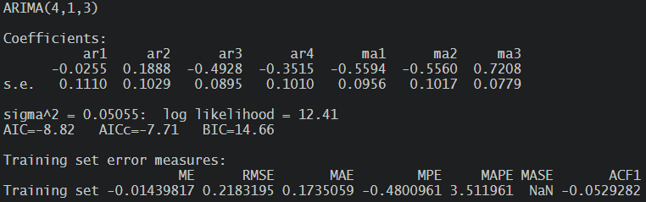
Process of building a Arima Model
- Identification of best fit ARIMA model.
auto.arima function in forecast package in R helps us identify the best fit ARIMA model.
based on Akaike Information Criterion (AIC) , and Bayesian Information Criterion (BIC) values.
choose a model with minimum AIC and BIC values
Notes:
My next step is to Identify of best fit ARIMA model.
Auto arima function in forecast package in R helps us identify the best fit ARIMA model.
The best fit model is selected based on Akaike Information Criterion (AIC) , and Bayesian Information Criterion (BIC) values.
The idea is to choose a model with minimum AIC and BIC values.
“p”: Stands for auto regressive. Auto regression is referring to when past values are being used to predict the future values.
“d”: Stands for integration. Integration takes in the amount of differencing that will be used for the time series.
“q”: Stands for moving average. The moving average is the average you calculate when you take the different intervals.

Slide 12
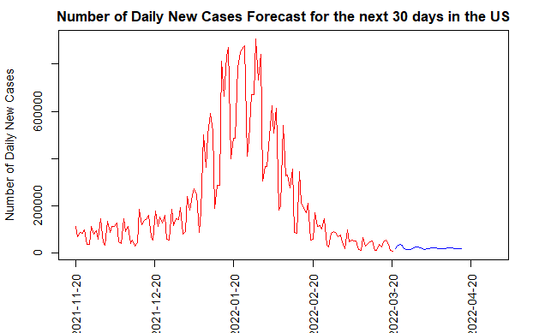
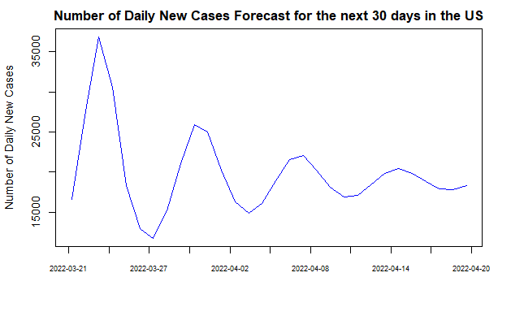
Forecast daily new cases using the best fit Arima Model
- Number of daily new cases forecast for the next 30 days in the US
Notes:
My next step is to Forecast daily new cases in the US using the best fit ARIMA model.
From the graph, we can see our model predicts a decreasing trend for the number of daily new cases in the next 30 days in the US.

Slide 13
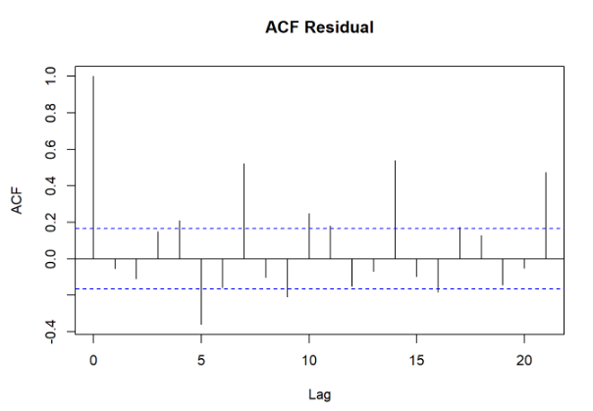
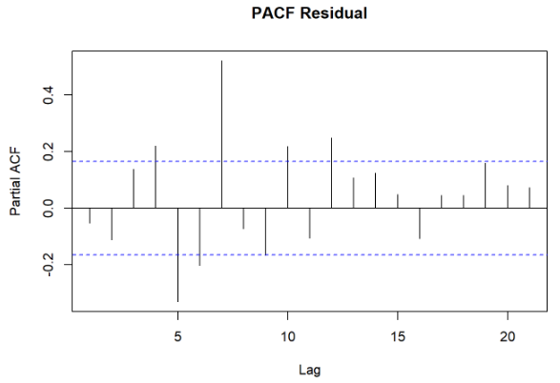
Forecast daily new cases using the best fit Arima Model
- Plot ACF and PACF for residuals of ARIMA model to ensure no more information is left for extraction.
Notes:
Finally, let’s create an ACF and PACF plot of the residuals of our best fit ARIMA model
Since the mean of the residuals is close to zero and there is no significant correlation in the residuals series for both ACF and PACF plots, we can conclude that residuals are random with no information left.
Hence our ARIMA model is working good and predictions were successfully made.

Slide 14
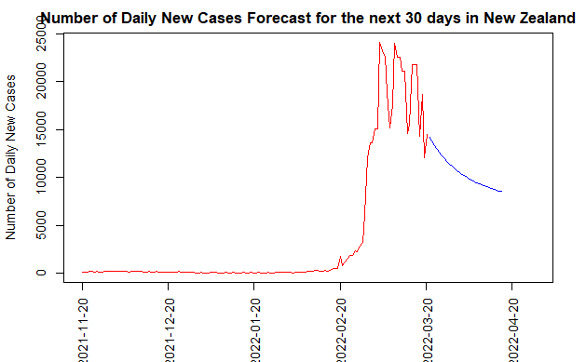
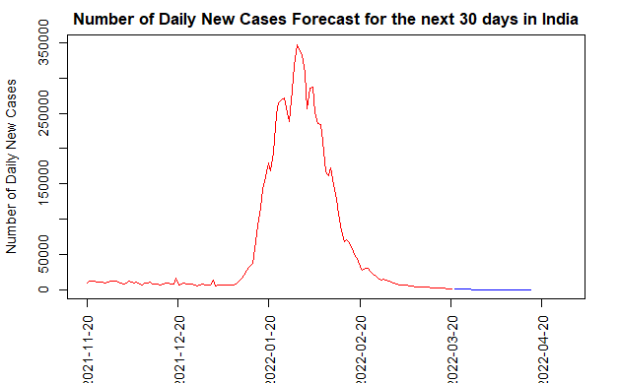
Forecast daily new cases using the best fit Arima Model
- more Country/Region
New Zealand
India
Notes:
I also built new models on predicting the daily new cases in other countries, such as new Zealand and India.
However, there have some limitation of arima model: for example, it has Poorer performance for long term forecasts.
Furthermore, arima model perform better when the data have a stable or consistent pattern over time,
As show above, the new Zealand data set does not show a consistent pattern, so the result may not that accurate because it ignore some possible movement over time.

Slide 15
Thank you
Notes:
Hope you enjoy this presentation, thank you

